Slide 1

ADVENTURE WORKS PROJECT
PRESENTED BY
SHABDAJIT LAWHARE

Slide 2
INTRODUCTION
The Adventure works Cycle is a manufacturing company and it manufactures the cycles , composite Bicycles , Mountain -100 black, Mountain -100 silver Which contributes Top sales and it sells to other countries like North America, European and Asia.
In 2000s, Adventure Works Cycles bought a small manufacturing plant in Mexico. Which manufactures several critical subcomponents for the Adventure Works Cycles product line. These subcomponents are shipped to the Bothell location for final product assembly. In 2001, this manufacturing plant became the sole manufacturer and distributor of the touring bicycle product group.

Slide 3
OBJECTIVE
Coming off a successful fiscal year, Adventure Works Cycles is looking to broaden its market share by targeting their sales to their best customers, extending their product availability through an external Web site, and reducing their cost of sales through lower production costs.
The main Motive of the project is to analyze the dataset and get actionable insights to improve the business profitability and try to enlarge the company to more Countries By Identifying best customers and to reduce the cost of sales by decreasing the production cost.

Slide 4
DATA COLLECTION AND PREPARATION
Data Source Details:
Provided by - Team Leader Terli Naveen Kumar
Date received –29-07-2025
Delivery Method –Through Gmail.
Data Overview:
Format – Excel .xlsx
No. of Tables – 8
Table names – Dim date, Dim Customers, Dim sales Territory, DimProduct, Dimproductcategory, DimProdSubCategory, FactInternetSales, FactinternetSales_new

Slide 5
Data Lineage & Transformations:
I have assigned proper data type of each and every columns.
Removed Unwanted Columns.
Added Custom Calculated Columns.
Append the Factinternetsales and FactinternetSales_new Tables.
I have done with merging the tables which consists all Product details.
Created relationships between each and every tables.
The type of Relationship is one to Many.
Replaced Nulls in Measure Columns with 0.
Replaced Nulls in dimension Columns with NA.

Slide 6
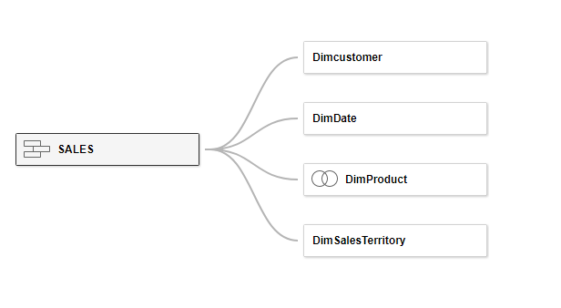
ABOUT THE DATASET –STAR SCHEMA

Slide 7
TOOLS
Excel – Used for data cleaning in power query tab , create Relationships in power pivot and Finally For Data Visualization.
Power BI – A widely Used tool for Creating Data Visualization and get Hidden insights To improve the business.
SQL- Data Retrieval and Extraction: SQL allows analysts to Query data bases and extract specific subsets of data based on defined criteria.
Tableau – It is used to quickly transform complex data into easily understandable, interactive, and shareable visual dashboards and reports, which helps them discover trends, gain insights, and make data-driven business decisions.

Slide 8
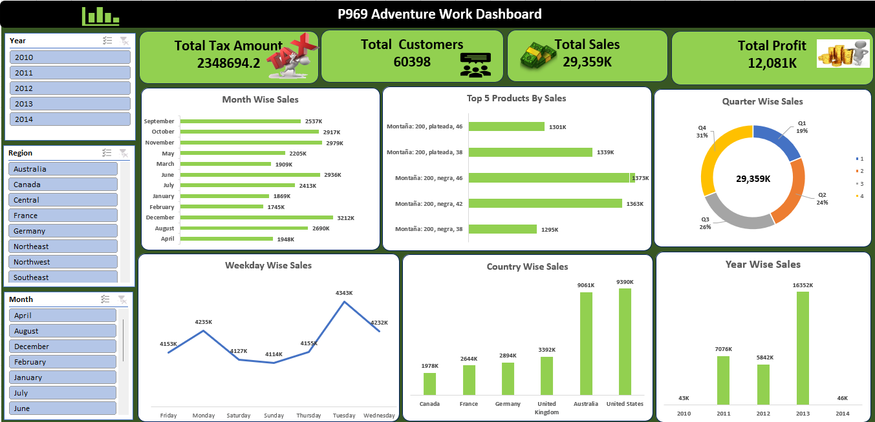
DASHBOARD DESIGNS-EXCEL DASHBOARD

Slide 9
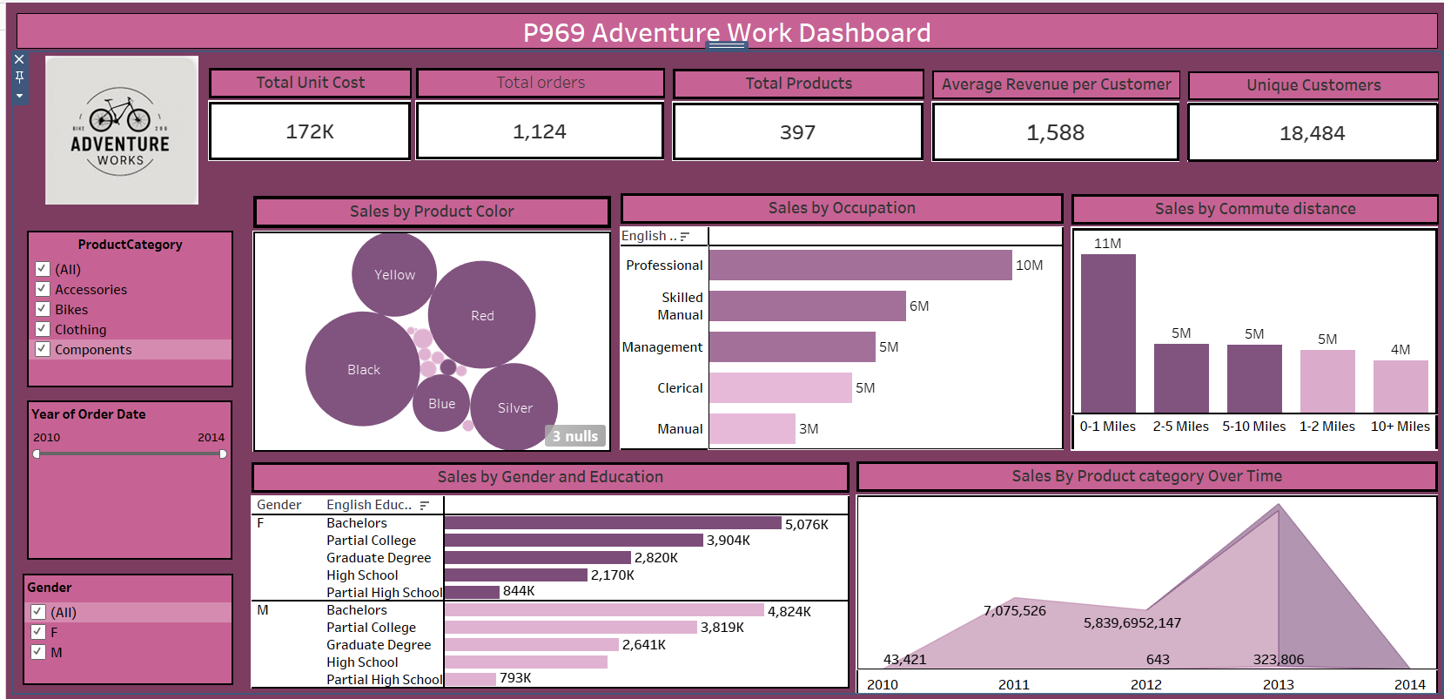
TABLEAU DASHBOARD

Slide 10
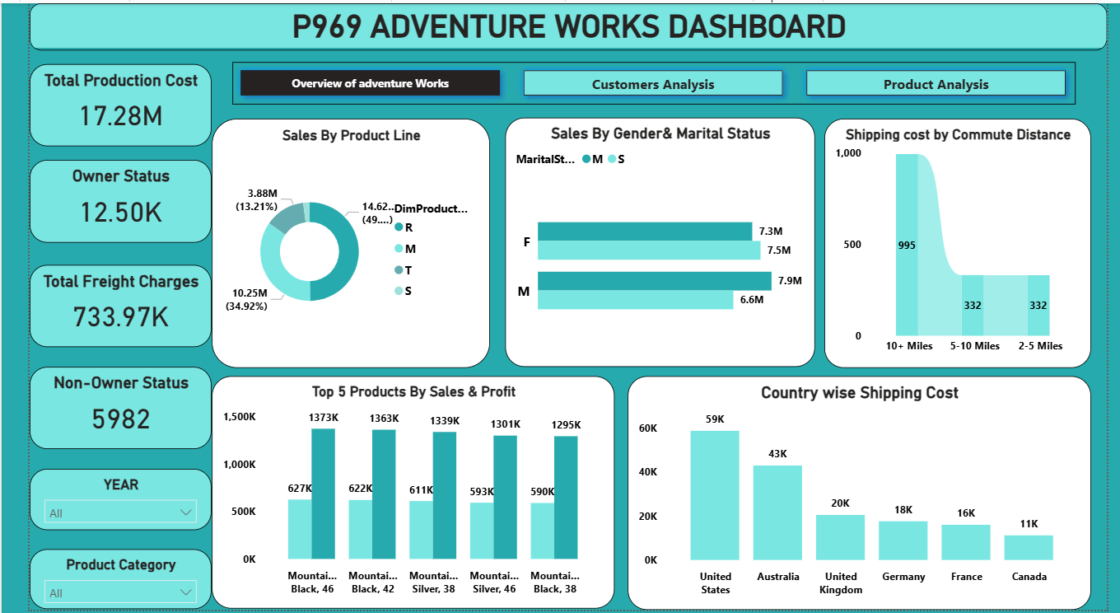
POWER BI DASHBOARD OVERVIEW

Slide 11
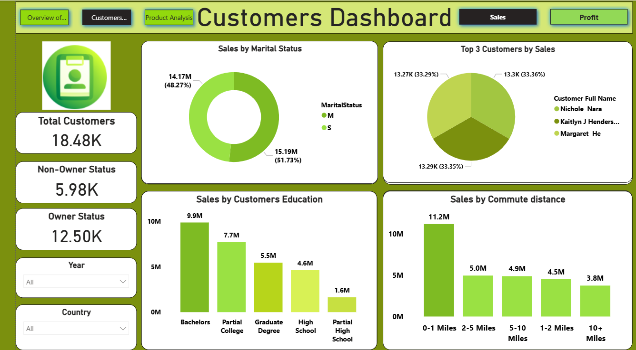
CUSTOMER ANALYSIS BY SALES

Slide 12
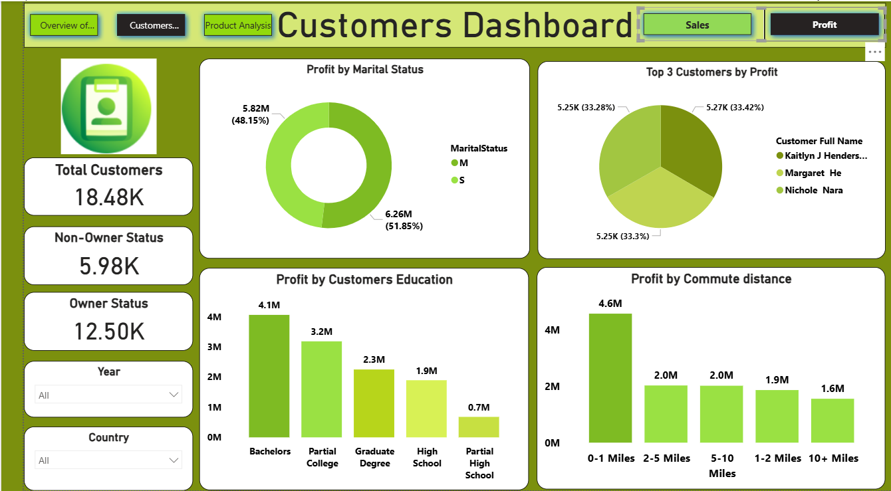
CUSTOMER ANALYSIS BY PROFIT

Slide 13
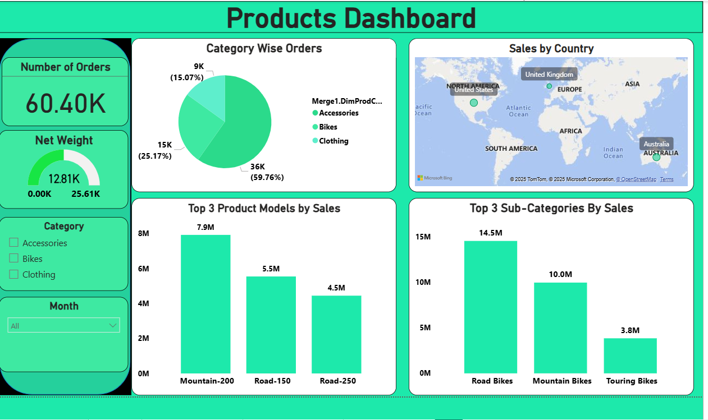
PRODUCT ANALYSIS

Slide 14
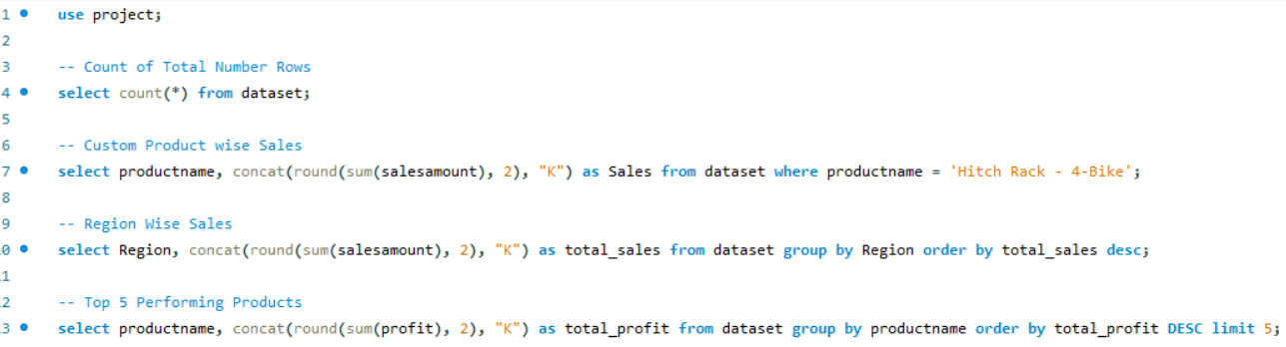
SQL QUERIES

Slide 15
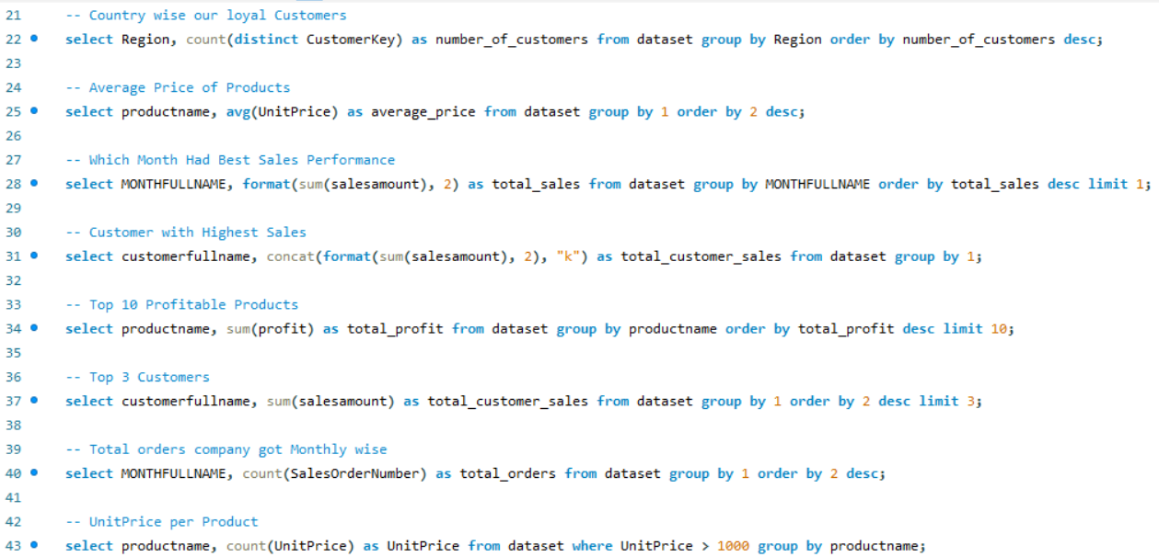

Slide 16
KEY INSIGHTS& RECOMMENDATIONS
1. Use just-in-Time (JIT) inventory – match production to demand minimizing finished goods and raw material stock. This lowers inventory holding costs & reduce waste.
As you can see in the excel dashboard we have Top 5 products by Sales Which Gains more profitability Compared to other products So we can invent this products more than we can decrease the production cost which automatically lower the cost of sales.
Sales by product colour in this chart it represents we are getting high sales due to Mostly black, red, silver, yellow Colour products.
Category Wise Sales represents we are getting high sales due to Bikes, Accessories Category only.
Sales by Product line Represents we are getting high sales due to road ,Mountain bicycles.

Slide 17
Top 3 Product models By Sales Represents high Sales due to Mountain-200,Road -150,Road -250.
Top 3 Sub-category By sales represents high Sales due to Road bikes, Mountain bikes, touring bikes.
2. Automation – Invest in automated processes robots and assembly lines to reduce labour costs , improve accuracy & increase speed, even though there may be an initial investment.
As we can see that we are getting high sales due to Bikes Category It is nearly 20.86 millions and If we go for depth analysis We are getting High Sales due to Road bikes Sub-category and But coming to manufacturing it takes Mostly 4 days which consumes more time compared to other category Products. For this Problem statement we can prefer Automation process.
One more Solution is For this problem is Employee training.

Slide 18
3. Employee Training – Invest in comprehensive employee training to increase Productivity ,Enhance skills& reduce errors.
4. Shipping cost by Commute distance Represents the high freight charges for 10+ miles but in actual if we can see we are getting high sales due to 0-1 miles Commute distance. So Reject the orders from Fare distance and try to explain the customers that we have shipping facility for only 2-5 miles Commute distance.
5. Sales by Occupation represents high sales due to professional only. To increase sales among others we can create bundles or starter kits at accessible price points—e.g., basic bike + essential accessories.
Develop messaging and promotions for clerical/manual laborers that emphasize durability, low maintenance, and practical value.
Use vouchers or small rewards for referral or repeat visits.

Slide 19
Extending Product Availability Through an External Website
a. Build E-commerce Capability
Expand the site to support online ordering, order-tracking, advanced search tools, and multi-currency support.
b. Improve Service via Portal Features
Consider an extranet or secure e-commerce portal offering real-time stock visibility, pricing details, and streamlined ordering.

Slide 20
CONCLUSION
Finally We can increase the profitability of Adventure works Cycle Company by reducing the cost of sales through lower production cost by just following the below methods.
Using just-in-Time(JIT) inventory method.
Automation Which Decreases the Labour cost.
Employee Training.
Explaining the Customers About Shipping Facilities.
Attracting customers by keeping a lot of offers and Discounts.
Giving Advertisements in News papers, Social Media to increase the demand in market.
Making availability through a external website in online.

